Slide 1
Reconciliation of cost and financial accounts
Dr. Manisha Shedge

Slide 2
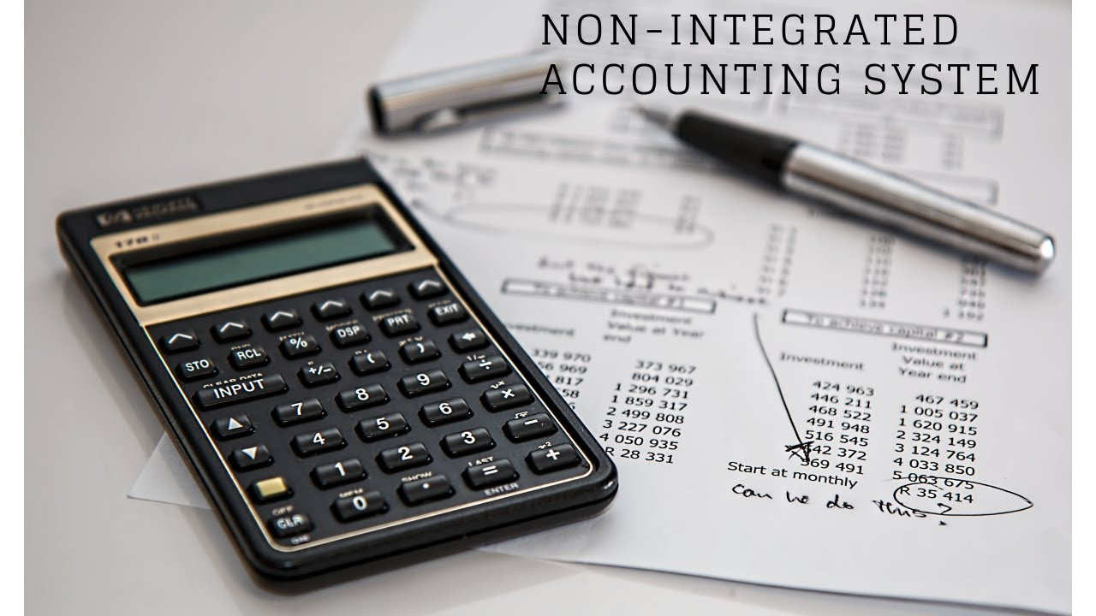
Introduction
In companies that follow the non-integrated accounting system, there are two sets of books of accounts that are prepared, the financial accounts and the cost accounts
They both deal with the same basic transactions in different manners and approaches and hence there is usually a difference in the final profit/loss that is obtained.
Hence, there is a need to reconcile both the sets of accounts.

Slide 3
Need for reconciliation
To find out the reasons for the difference in profit/loss shown by cost accounts and financial accounts
To ensure the mathematical accuracy and reliability of cost accounts in order to have appropriate cost ascertainment and cost-control.
To facilitate coordination and promote better cooperation between the activities of financial and cost sections of the accounting departments.
To place the management in better position to acquaint itself with the reasons for variation in profit/loss and paving the way for more effective internal control
for standardization of policies regarding stock valuation, recovery of overheads, etc.

Slide 4


Reasons for differences
Items included only in financial accounts
  Purely financial expenses
    Loss on capital assets
    Stamp duty and expenses on issue and transfer of stock, shares and bonds
    Loss on investments
    Discount on debentures, bonds
    Fines and penalties
    Interest on bank loans

Slide 5

Reasons for differences
  Purely financial income
    Rent received
    Profit on sale of assets
    Share transfer fee
    Share premium
    Interest on investment, bank deposits
    Dividends received
  Appropriation of profit – donations and charities

Slide 6
Reasons for differences
Items included only in cost accounts
  There are very few items which appear in cost accounts, but not in financial accounts.
    interest on capital, which is not paid but included in cost accounts to show the notional cost of employing capital
    rent i.e. charging a notional rent of premises owned by the proprietor
Items accounted for differently in cost accounting and financial accounting
  Overhead
  Stock valuation
  Depreciation

Slide 7
Steps in reconciliation
Ascertain the extent of difference between the profit or loss disclosed by two set of book of accounts.
Take the base profit/loss as per any set of books as the starting point.
Prepare a statement by making suitable adjustment of items either added/subtracted included in one set of accounts but not in the other set.

Slide 8
Methods of reconciliation
There are mainly two methods of preparing the reconciliation statement
  Statement of Reconciliation
    It is a statement which exhibits the items to be added or subtracted to bring the balance profit/loss of cost books in agreement with the profit/loss as disclosed in financial books.
  Memorandum Reconciliation Account
    Memorandum Reconciliation Account performs the same function of reconciliation statement. The difference is the presentation of reconciliation statement in ‘T’ shape form. It is called memorandum account because it does not form part of double entry.

Slide 9
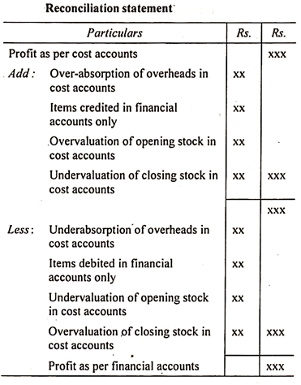
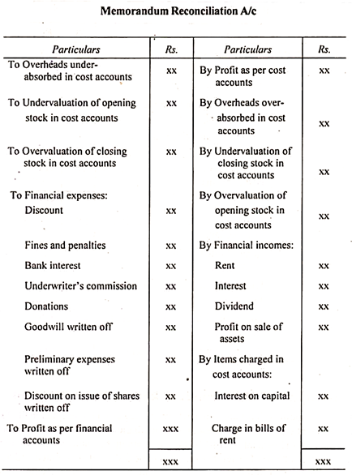
Proforma of methods

Slide 10
Reconciliation example
A manufacturing company disclosed a Net Loss of ₹5,72,000 as per their Cost Accounts for the year ended 31st march, 2021. The Financial Accounts however disclosed a Net Loss of ₹8,84,000 for the same period.
The following information was revealed as a result of scrutiny of the figures of both the set of Books.
Particulars | Amount
Factory Overheads Over-absorbed | 16,000
Administration Overheads under absorbed | 24,000
Depreciation charged in Financial Accounts | 2,20,000
Depreciation charged in Cost Accounts | 2,45,000
Interest on Investments | 64,000
Income Tax Provided | 1,54,000
Interest on loan funds | 2,63,000
Transfer fees (Credits in financial books) | 16,000
Stores adjustment (Credit in financial books) | 8,000

Slide 11
Memorandum reconciliation account
Particulars | Amount | Particulars | Amount
To Net Loss as per Costing Books | 5,72,000 | By Factory Overheads Over Absorbed | 16,000
To Administration Overheads Under Recovered | 24,000 | By Interest on Investment | 64,000
To Income Tax not provided in Cost Accounts | 1,54,000 | By Depreciation Over Charged to Cost Accounts | 25,000
To Interest on Loan Fund | 2,63,000 | By Transfer Fees | 16,000
 |  | Stores Adjustment in financial books | 8,000
 |  | By Net Loss as per Financial Books (b/f) | 8,84,000
 | 10,13,000 |  | 10,13,000

Slide 12
reconciliation statement
Particulars | Amount | Amount
Net Loss as per Financial Accounts |  | 8,84,000
Add: Factory Overheads Over Absorbed | 16,000
Interest on Investment | 64,000
Depreciation Over Charged in Cost Accounts | 25,000
Transfer Fees | 16,000
Stores Adjustment | 8,000 | 1,29,000
 |  | 10,13,000
Less: Administration Overheads Under Recovered | 24,000
Income tax | 1,54,000
Interest on Loan Fund | 2,63,000 | 4,41,000
Net loss as per Cost Accounts |  | 5,72,000

Slide 13
Thank You

